Slide 1
CSE 499A
Section - 15
Group - 03
Group - 03
Md. Kamrul Islam | Farhan Ishraque | Iram shehzad | Atikul Islam Nahid

Slide 2
Project Presentation
JobCore: AI Agent to Automate Your Job Hunt in Seconds
Group - 03
Md. Kamrul Islam | Farhan Ishraque | Iram shehzad | Atikul Islam Nahid

Slide 3
ABOUT US
Md. Kamrul Islam
2211745642
Farhan Ishraque
2212002042
Atikul Islam Nahid
2211978042
Iram shehzad
2131614642
Group - 03
Md. Kamrul Islam | Farhan Ishraque | Iram shehzad | Atikul Islam Nahid

Slide 4





WHY THIS APPLICATIONS
Multiple Platforms
Time Consuming
Manual Application
Personal Feedback
Mock Interview
Group - 03
Md. Kamrul Islam | Farhan Ishraque | Iram shehzad | Atikul Islam Nahid

Slide 5
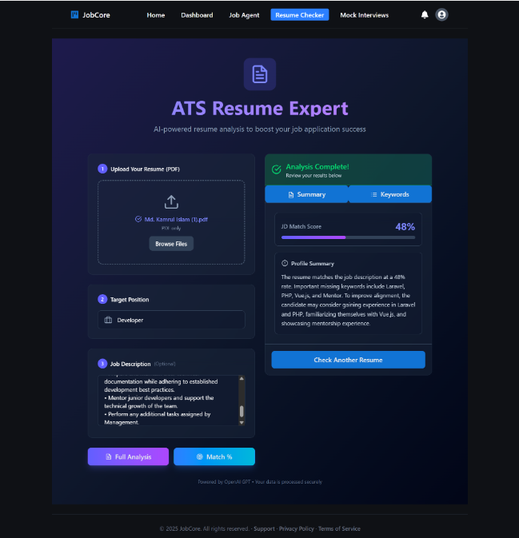
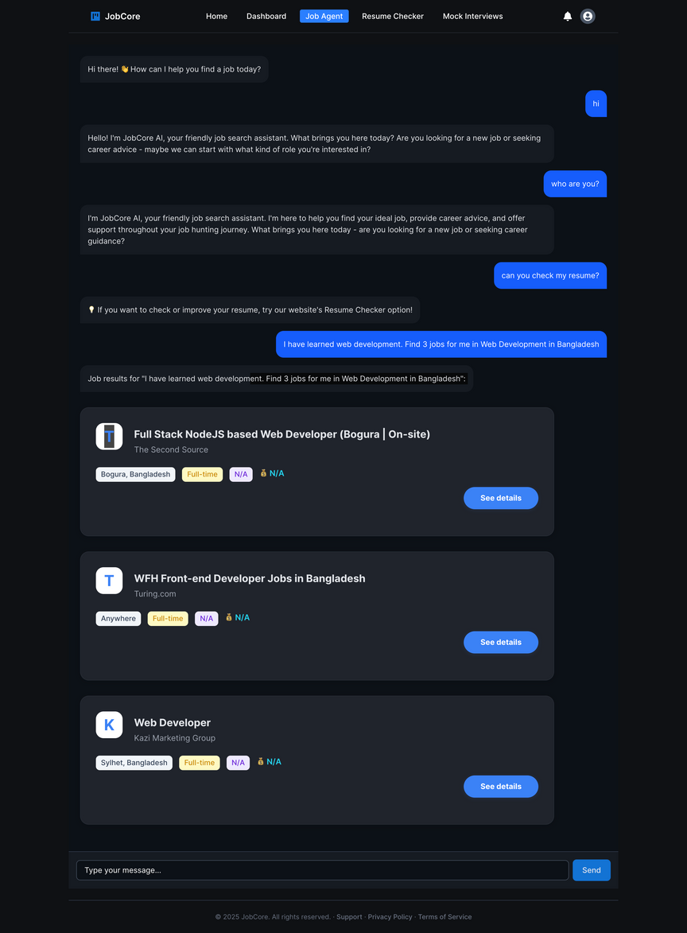
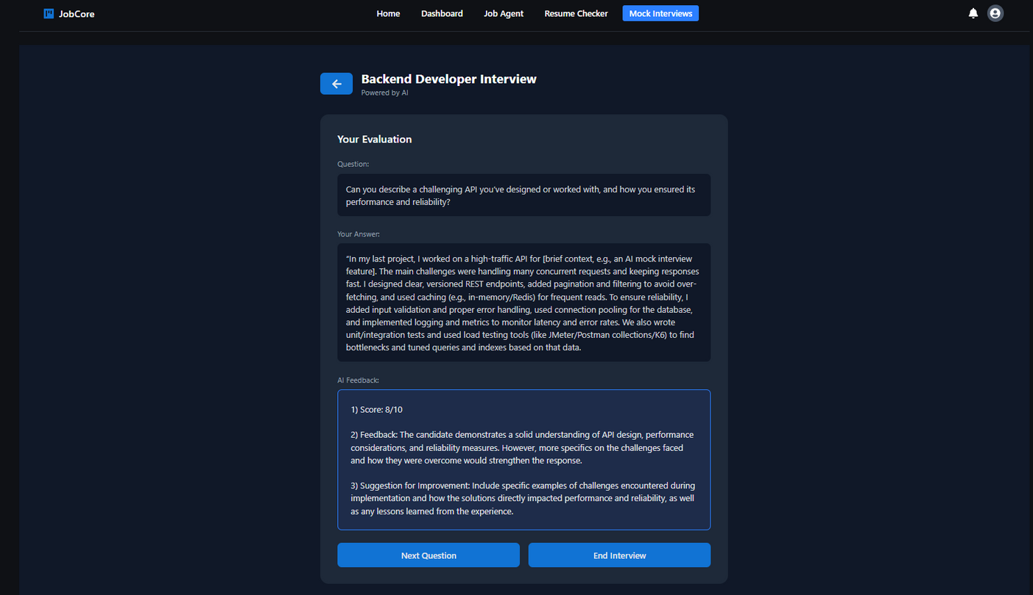
OUR SOLUTION
Resume optimization
Search the targeted
job more faster
Mock interview
Group - 03
Md. Kamrul Islam | Farhan Ishraque | Iram shehzad | Atikul Islam Nahid

Slide 6
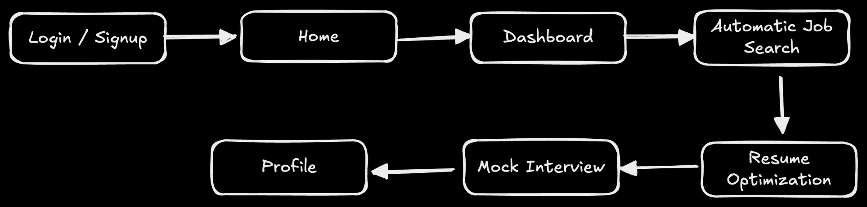
SYSTEM OVERVIEW
Group - 03
Md. Kamrul Islam | Farhan Ishraque | Iram shehzad | Atikul Islam Nahid

Slide 7
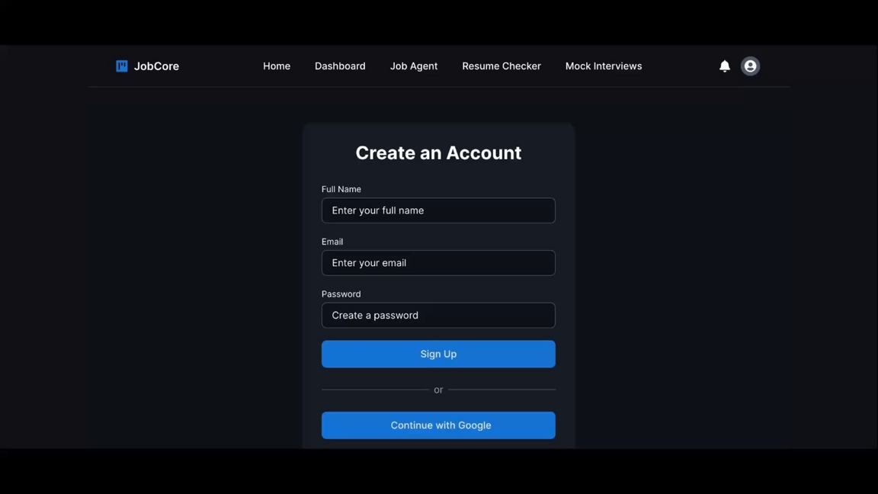
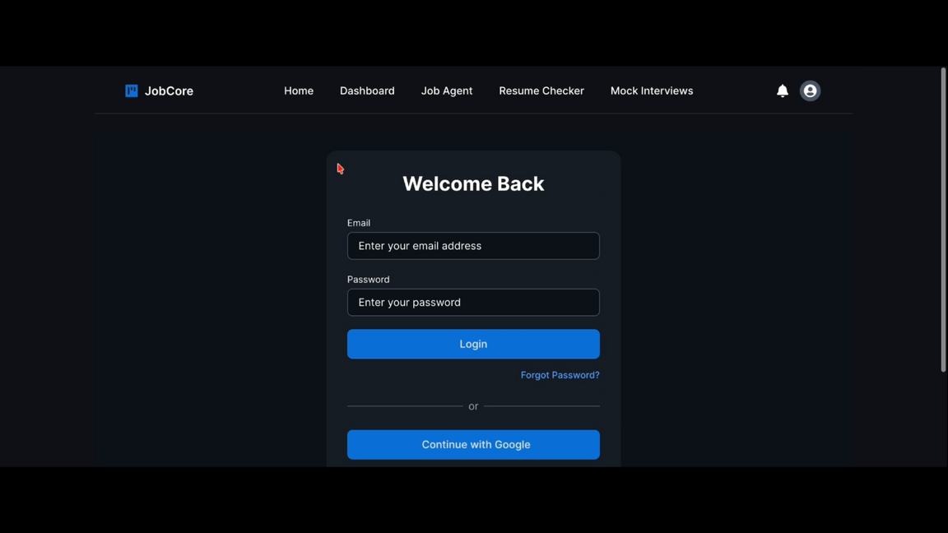
SYSTEM INSHORT
Sign Up
Log In
Group - 03
Md. Kamrul Islam | Farhan Ishraque | Iram shehzad | Atikul Islam Nahid

Slide 8
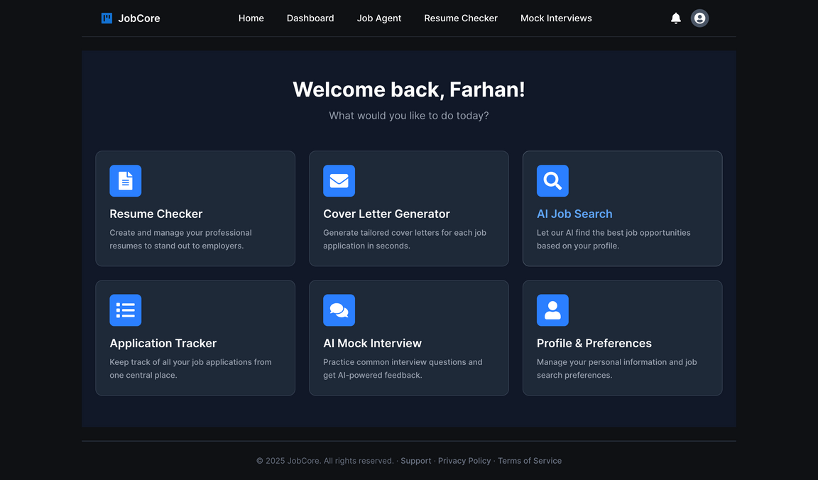
SYSTEM INSHORT
Dashboard
Group - 03
Md. Kamrul Islam | Farhan Ishraque | Iram shehzad | Atikul Islam Nahid

Slide 9
SYSTEM INSHORT
AI Job Search
Group - 03
Md. Kamrul Islam | Farhan Ishraque | Iram shehzad | Atikul Islam Nahid

Slide 10
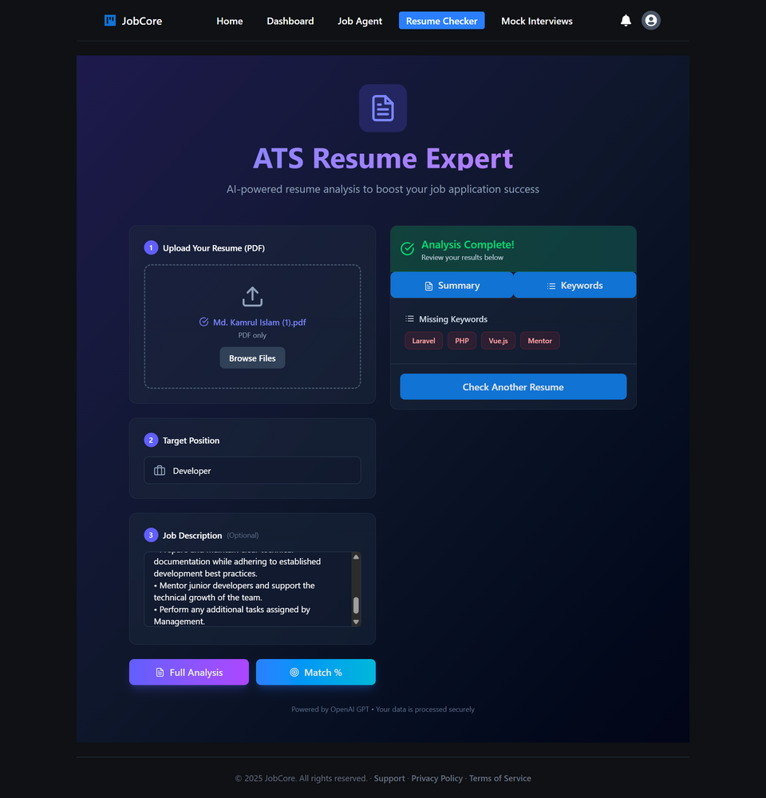
SYSTEM INSHORT
Resume optimization
Group - 03
Md. Kamrul Islam | Farhan Ishraque | Iram shehzad | Atikul Islam Nahid

Slide 11
SYSTEM INSHORT
AI Mock
Interview
Group - 03
Md. Kamrul Islam | Farhan Ishraque | Iram shehzad | Atikul Islam Nahid

Slide 12









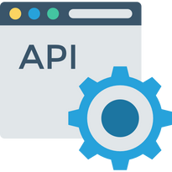

TECH STACK
Frontend
Backend
Database
Others
Group - 03
Md. Kamrul Islam | Farhan Ishraque | Iram shehzad | Atikul Islam Nahid

Slide 13
FUTURE PLAN
Integrate custom-trained AI models
Job auto-apply automation.
Voice-based interview simulations.
Personalized resume and cover letter generation
Group - 03
Md. Kamrul Islam | Farhan Ishraque | Iram shehzad | Atikul Islam Nahid

Slide 14
CONCLUSION
This product will help job seekers automate the application, preparation, and testing process faster and smoothly, which might increase the chance of getting the job.
Group - 03
Md. Kamrul Islam | Farhan Ishraque | Iram shehzad | Atikul Islam Nahid

